Slide 1

Functions

Slide 2
Topics
Basic Function
Passing Value through Parameter
Passing only some values through Parameters
Setting Default Value to Parameter

Slide 3
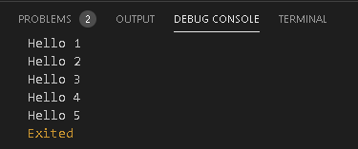
Basic Function
void sayHello(){
for(int counter=0;counter<5;counter++){
print("Hello ${counter+1}");
}
} void main() {
sayHello();
}

Slide 4

Passing Value through Parameter
String mergeString(String first,String last){
print(first+' '+last);
}
void main() {
mergeString("Prateek","Mewara");
}

Slide 5
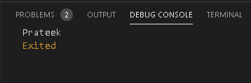
Passing only some values through Parameters
String mergeString({String first,String last}){
if(last==null){
print(first);
}
else{
print(first+' '+last);
}
}
void main() {
mergeString(first: "Prateek");
}

Slide 6
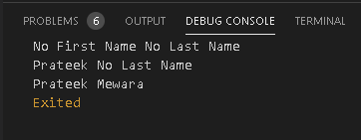
Setting Default Value to Parameter
String mergeString([String first="No First Name",String last="No Last Name"]){
print(first+' '+last);
}
void main() {
mergeString();
mergeString("Prateek");
mergeString("Prateek","Mewara");
}

Slide 7
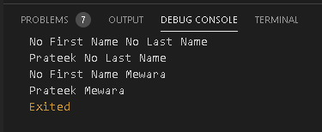
Another Way
String mergeString({String first="No First Name",String last="No Last Name"}){
print(first+' '+last);
}
void main() {
mergeString();
mergeString(first:"Prateek");
mergeString(last:"Mewara");
mergeString(first:"Prateek",last:"Mewara");
}

Slide 8
Thank You

